Slide 1
DREAM WAVE-ADAPTIVE PERSONALIZED SLEEP IMPROVEMENT THROUGH DATA-DRIVEN INSIGHTS
Dr. Premkumar Chithaluru
Project guide
Akshitha– 23261A1204
Rishwan – 23261A1211
Sai Sree – 23261A1222

Slide 2
INDEX
Abstract
Literature survey
Existing systems
-Description
-Limitations
Proposed solution
Hardware & Software requirements
Architecture
Modules
Design
- Class Diagram
-Use Case Diagram
-Sequence Diagram
-Activity Diagram
Implementation
-Algorithm Implementation and Pseudo Code
-Data Set Description and Analysis .
Test Case
Output
References

Slide 3
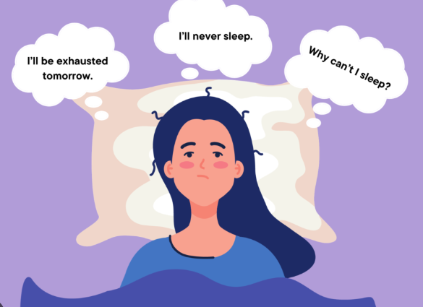
ABSTRACT
The Problem:
Millions struggle with irregular sleep, insomnia, and poor habits leading to
weakened immunity, cognitive decline, and health risks.
The solution:
Dream-wave is an AI-powered recommendation system for rebalancing circadian rhythms and improving sleep wellness. Unlike traditional biofeedback-based systems, it relies on user-provided inputs
The system processes these inputs to provide personalized suggestions, such as:
Dietary changes
Meditation
Stress management techniques
Screen time reduction strategies
Integrates cybernetic health principles to adapt to individual habits . Promotes holistic well-being and sustainable sleep patterns.

Slide 4
LITERATURE SURVEY
TITLE: Monitoring and Improving Personalized Sleep Quality from Long-Term Lifelogs YEAR: 2022 Uses wearable and IoT sensor data to predict sleep quality before bedtime and provide personalized tips using the PerSQ deep-learning model.
TITLE: A Personalized Adaptive Algorithm for Sleep Quality Prediction using Physiological and Environmental Sensing Data YEAR: 2021 Proposes an adaptive ensemble learning algorithm that updates daily to improve sleep efficiency predictions using both global and personal data.
TITLE: AI Empowered Virtual Reality Integrated Systems for Sleep Stage Classification and Quality Enhancement YEAR: 2022 Uses EEG-based machine learning and VR-driven therapy to improve sleep quality, showing better results than traditional methods in clinical tests.

Slide 5
LIMITATIONS OF EXISTING SYSTEMS
Circadian Rhythms, Sleep Deprivation, and Human Performance
While insightful, this research is theoretical and lacks direct implementation strategies for personalized interventions.
Personal Recommendation System for Improving Sleep Quality
Relies heavily on wearable sensors, which may be inconvenient for users, and data-driven insights may not always align with subjective sleep experiences.
Context-Aware Lifestyle Recommendations
Struggles with overgeneralization, often placing users into fixed behavioral clusters rather than dynamically adapting to individual lifestyle changes in real time.

Slide 6
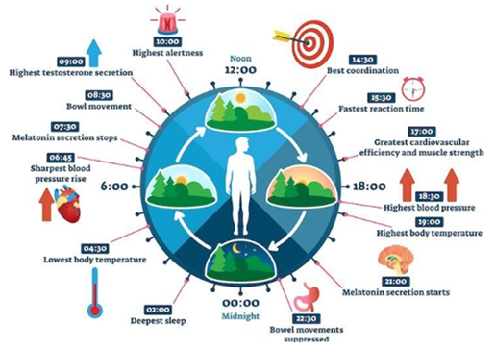
PROPOSED SOLUTION
Dream-wave leverages AI-driven insights to help users rebalance their circadian rhythms and
improve sleep wellness through personalized recommendations based on their lifestyle patterns.
Advantages
More Accurate & Personalized Insights
Eliminates Overgeneralization
No Wearable Dependency
Real-Time AI-Driven Adaptation
Cybernetic Health Integration
Real-Time, AI-Driven Adaptation
Effortless & Engaging User Input
Holistic Sleep Management

Slide 7
Existing systems
Circadian Rhythms, Sleep Deprivation, and Human Performance:
This paper explores effects of sleep homeostasis and circadian rhythms on brain metabolism and performance. Understanding these interactions can help in developing algorithms that consider both sleep quality and cognitive performance.
Personal Recommendation System for Improving Sleep Quality:
This study discusses using long-term monitoring of vital data through body sensors and mobile applications to estimate sleep quality and provide real-time recommendations. It employs machine learning and big data analysis techniques, which could be instrumental for your recommendation engine
Personalized User Modelling for Context-Aware Lifestyle Recommendations to Improve Sleep:
This research focuses on creating personalized sleep models by analysing the causal relationships between daily activities and sleep quality. Using N-of-1 experiments and event mining on longitudinal user data, the model identifies patterns and generates context-aware lifestyle recommendations.

Slide 8
Hardware and Software requirements
Hardware
Software
Processor: Intel Core i3 or higher
RAM: 4GB or more
Storage: Minimum 500GB HDD or SSD
Internet Connection: Required for data syncing and updates
Display: 1280x720 resolution or higher (for web interface)
Operating System:
Windows 10 or higher
macOS 10.14 or higher
Linux (Ubuntu or similar distributions)
Backend Development:
Python 3.x (for algorithm and AI model development)
Flask or Django (for API integration)
Frontend Development:
React JS (for web interface)
HTML, CSS, JavaScript (for designing the user interface)

Slide 9
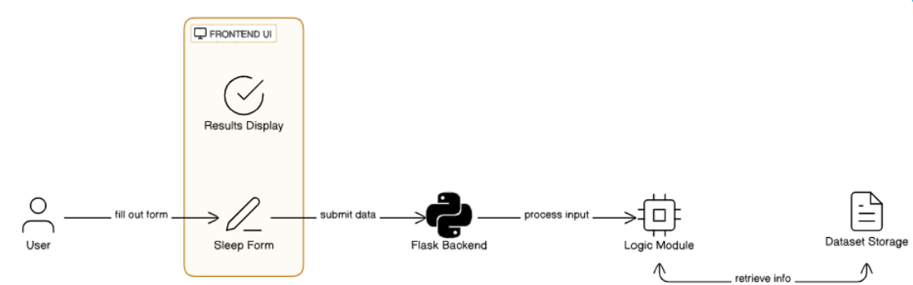
Dream Wave Architecture

Slide 10
MODULES
1. User Input Module
2. Frontend Module
3. Backend Module (Python with Flask)
4. AI Model Module
5. Database Module

Slide 11
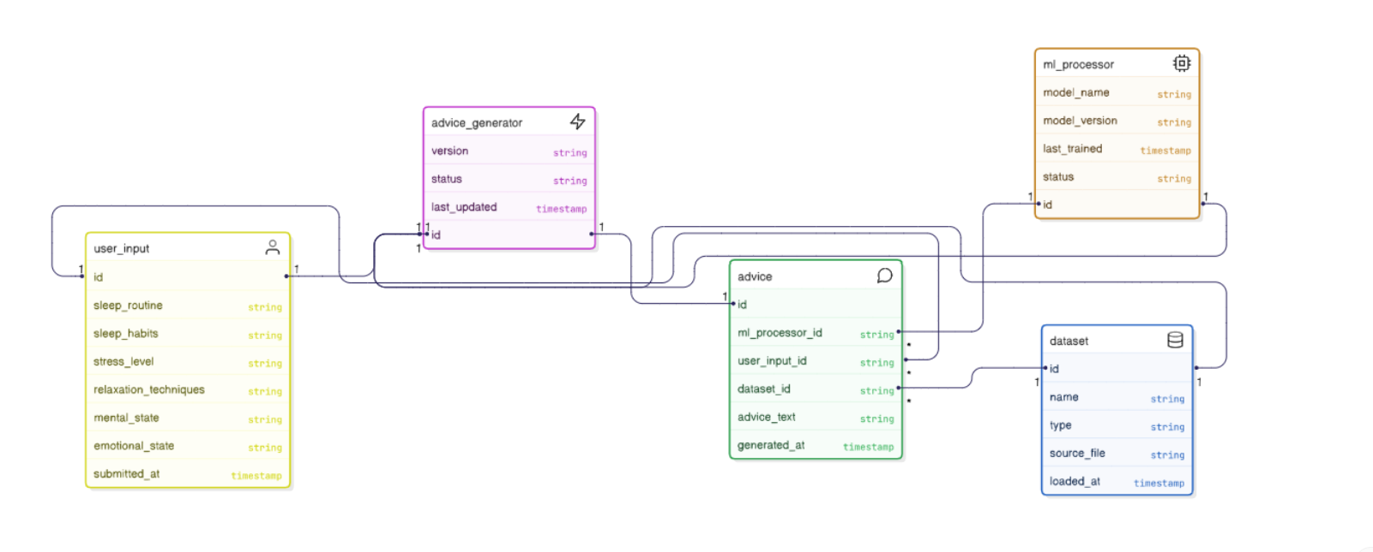
Class Diagram

Slide 12
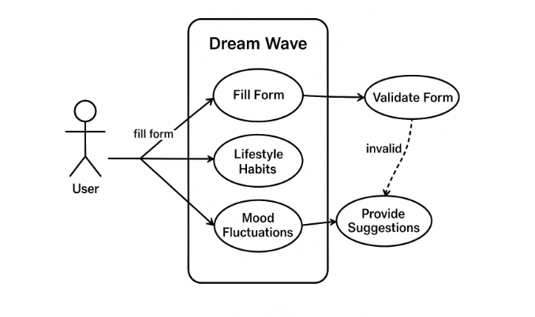
Use Case Diagram

Slide 13
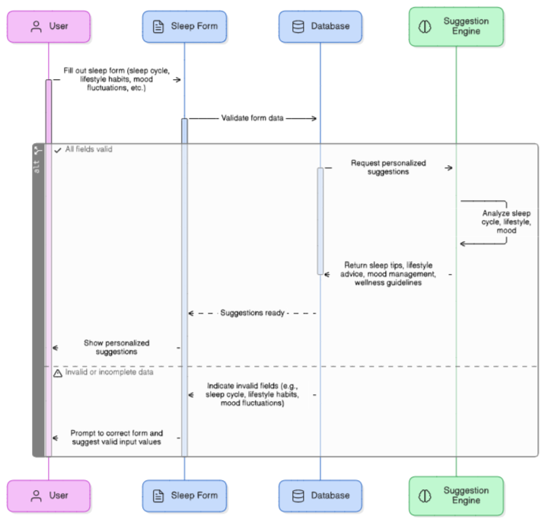
Sequence Diagram

Slide 14
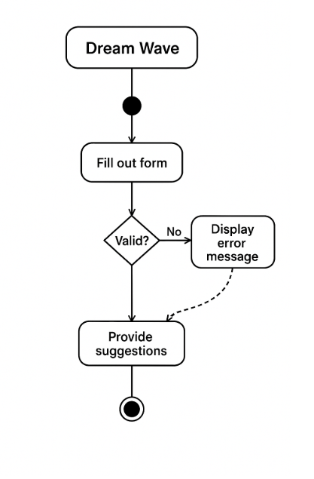
Activity Diagram

Slide 15
Algorithm Implementation and Pseudo Code
Input: new_user_data, dataset_features, dataset_labels, K
1. distances = []
2. For each data_point in dataset_features:
distance = EuclideanDistance(new_user_data, data_point)
distances.append((distance, corresponding_label))
3. Sort distances by distance value
4. Select K nearest neighbors
5. Get labels of the K neighbors
6. recommended_label = MostCommonLabel among K neighbors
7. Return recommended_label
End
K-Nearest Neighbors (KNN)
K-Nearest Neighbors (KNN) is a supervised machine learning algorithm used for classification and regression. It is based on the idea that similar inputs have similar outputs.
Key features:
No actual training phase — it stores the entire dataset.
K is a user-defined number (e.g., 3 or 5).
Distance (usually Euclidean) determines similarity.
Works best with small to medium-sized datasets.

Slide 16
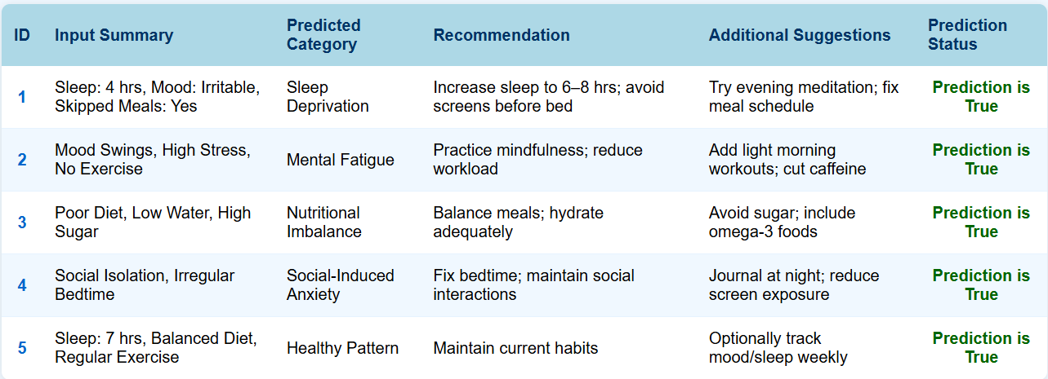
Test Cases

Slide 17
Test Cases
6.1.1 Unit Test
Tests individual components like input validation and prediction functions separately.
Ensures data preprocessing and label encoding work correctly.
Covers normal and edge cases to catch bugs early.
Automated using Python frameworks (e.g., pytest) for quick feedback.
Focuses on one function at a time for easy debugging and maintenance.
6.1.2 Integration Test
Verifies interaction between frontend form, backend logic, and ML models.
Checks data flow from user input to recommendation display.
Detects interface and communication issues between modules.
Tests full user workflow for consistent and correct output.
Uses strategies like top-down and bottom-up testing.

Slide 18
Test cases
6.1.3 Acceptance Test
Performed by users to validate the system meets real-world needs.
Confirms the questionnaire and recommendations work as expected.
Assesses usability, clarity, and relevance of advice.
Collects user feedback for final improvements.
Ensures DreamWave is ready for deployment and delivers real value.

Slide 19
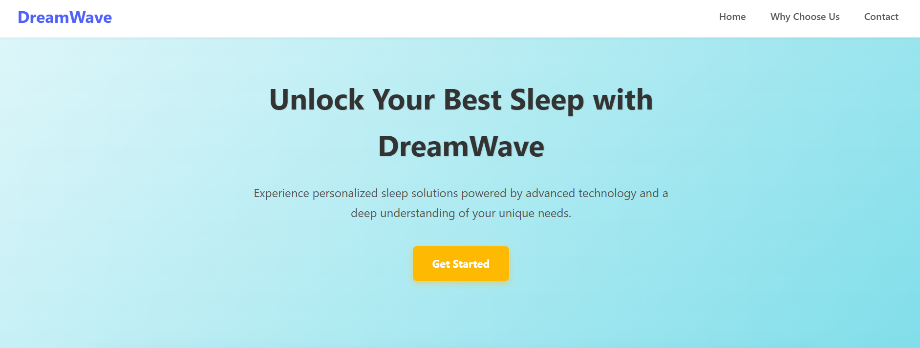
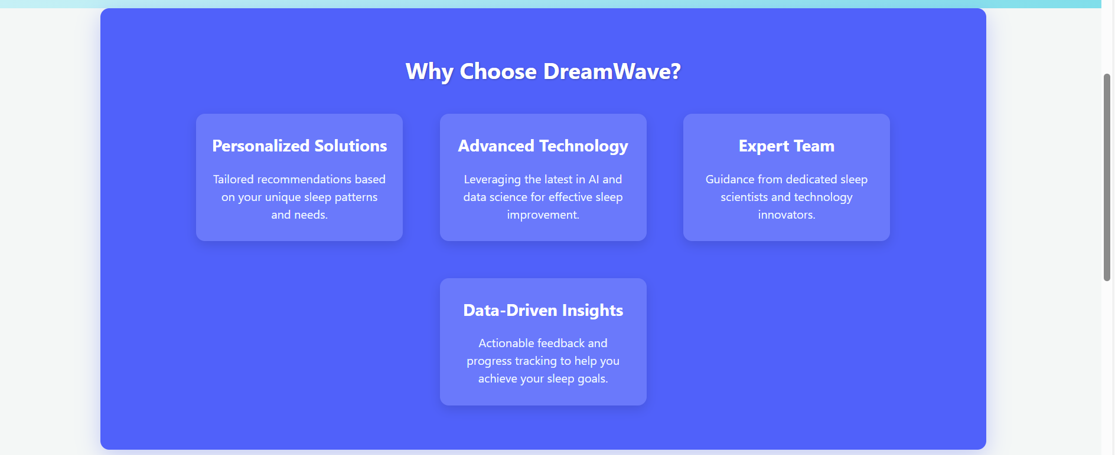
Output
Index page
About page

Slide 20
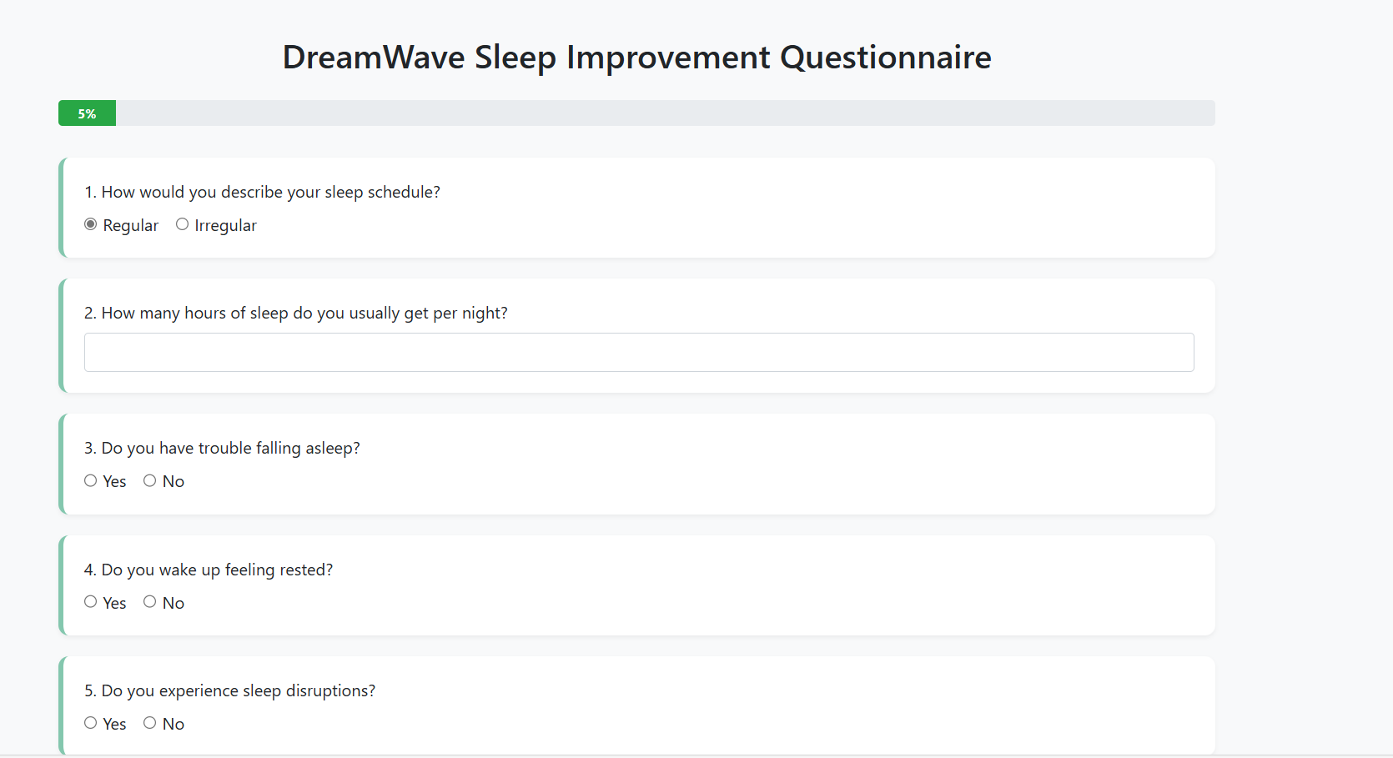
Outputs
Form page

Slide 21
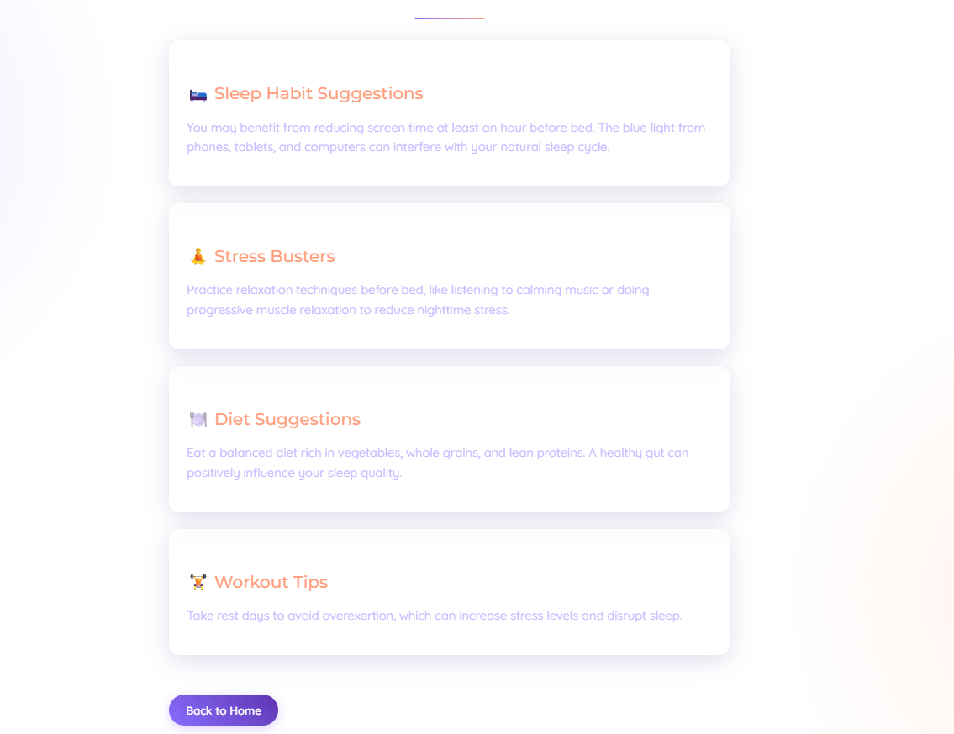
Outputs
Result page

Slide 22
References
Smith, J., Zhao, L., et al. Personal Recommendation System for Improving Sleep Quality. IEEE Transactions on Biomedical Engineering.[2016]
Johnson, B., Lee, R. Cybernetic Health: The Future of Personalized Wellness. Health Technology Journal.[2016]
Lopez, M., Singh, K. Machine Learning Applications in Sleep Science: A Review. Sleep Medicine Reviews.[2013]
Nguyen, D., Thomas, P. The Role of Psychosocial Factors in Sleep Quality. Journal of Behavioral Medicine.[2018]
Chen, L., Robinson, T. Big Data in Healthcare: Enhancing Personalized Medicine. International Journal of Medical Informatics.[2018]

Slide 23
.
Thank you!

